Slide 1

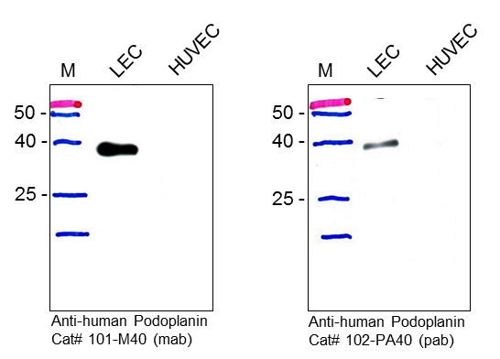
ReliaTech GmbH
Anti-Human Podoplanin (Gp36)
Fig. 1: Western blot analysis of Podoplanin expression in human lymphatic endothelial cells (LEC) and HUVECs. Total lysate of both cell types were subjected to SDS-PAGE and subsequent Western analysis using our monoclonal (#101-M40, clone 18H5) and polyclonal (#102-PA40) antibodies. Both antibodies recognize a protein of about 36 kDa in total lysate from LECs but not from HUVEC.
http://www.reliatech.de / orders@reliatech.de

